Slide 1
LLM for Gen AI
Dr. Monali Mavani

Slide 2

Disclaimer and Acknowledgement
The content for these slides has been obtained from books and various other source on the Internet
I here by acknowledge all the contributors for their material and inputs.
I have provided source information wherever necessary
I have added and modified the content to suit the requirements of the course

Slide 3

Session Agenda
Motivation
Retriever–Generator framework
Chunking strategies
Retrieval
Indexing and searching
Reranking
Context Engineering
Advanced RAG
Agentic RAG

Slide 4

Why LLMs need external knowledge
Everything an LLM knows is stored in its weights — and that has hard limits.
Parametric knowledge (in weights)
Frozen at training time — no new facts after the cutoff
Opaque — no way to see where an answer came from
Expensive to update — changing facts means retraining
No access to your data — private documents were never in the training set
How it shows up in answers
“Who won yesterday?”
Stale or refused — the event is past the cutoff
“What is our leave policy?”
Hallucinated — your policy was never seen
“Where did that come from?”
No citation possible — weights have no sources
Fix is not a bigger model — it is giving the model the right text at the right time.

Slide 5

Motivation
Knowledge of LLM constrained to pretraining data
knowledge cutoff date
  Gemini 3 Pro : January 2025
  GPT 5.2 : Aug 31, 2025
Limited context size
  Gemini 3 Pro : 1M
  GPT 5.2 : 400,000
Pricing is per input/output token
But, more context ≠ better answers
https://deepmind.google/models/model-cards/
https://platform.openai.com/docs/models

Slide 6

Long context alone does not fix it
“Just paste everything into the 128K window” fails in two ways.
1 · Recall degrades
2 · Cost scales with tokens
Needle-in-a-Haystack tests: retrieval accuracy drops at large context lengths
Worst when the fact sits mid-document (10–50% depth) — “lost in the middle”
Attention favours the start and end of the window
Every token in the window is processed on every query
100K tokens of mostly-irrelevant text, paid for again and again
Latency and cost grow even when the answer needed only 500 tokens
Conclusion: do not dump everything — select what goes into the window. That selection step is retrieval
Fine-tuning changes how the model behaves. RAG changes what it can know and say.

Slide 7
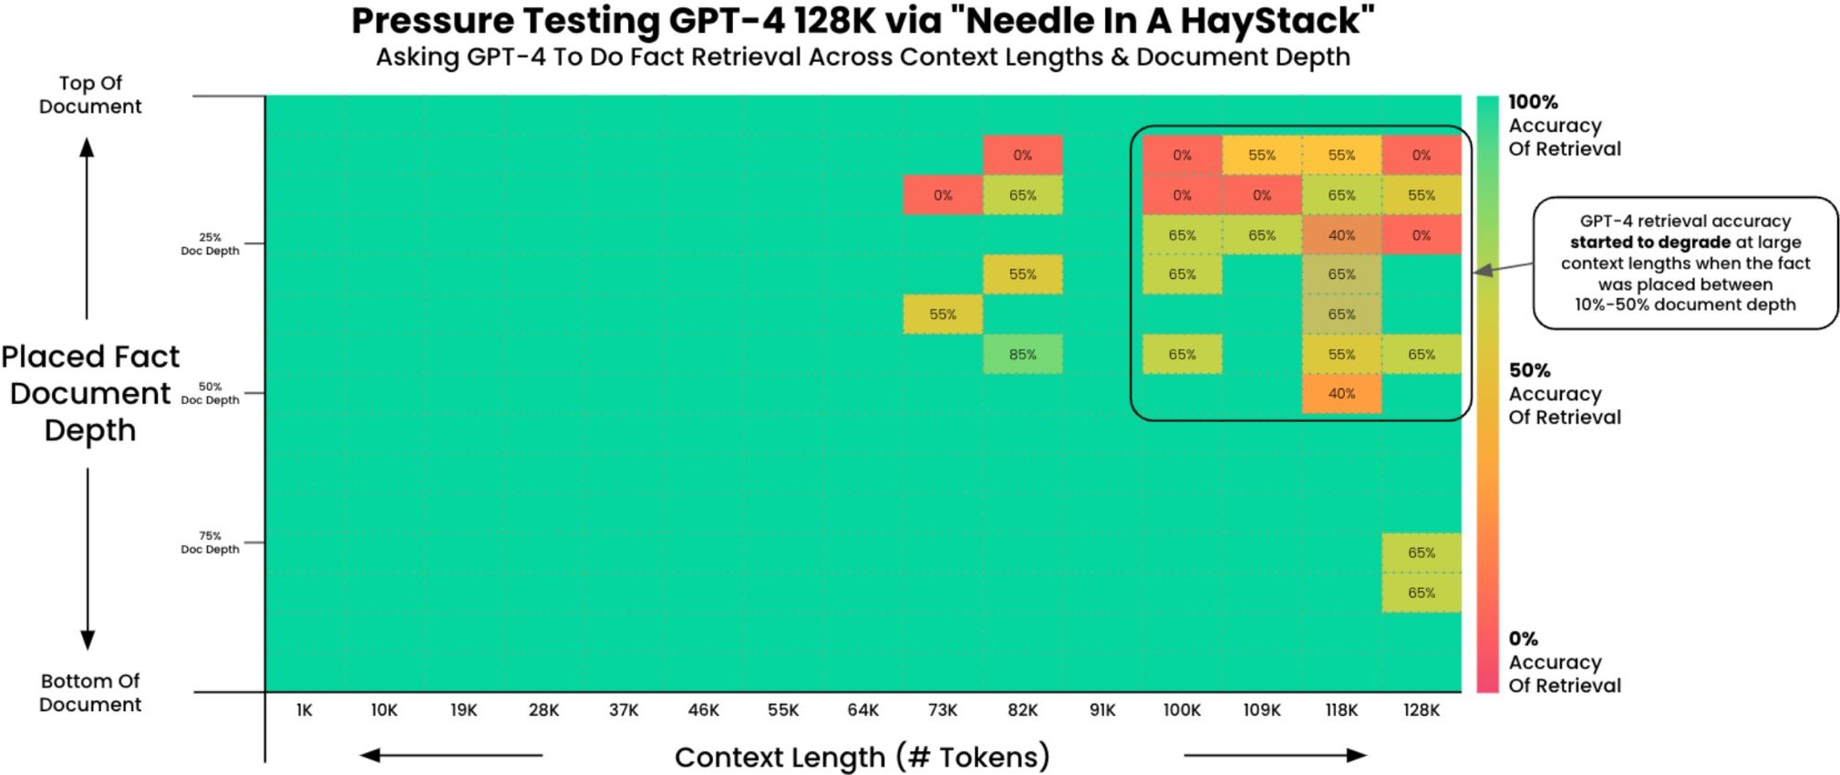
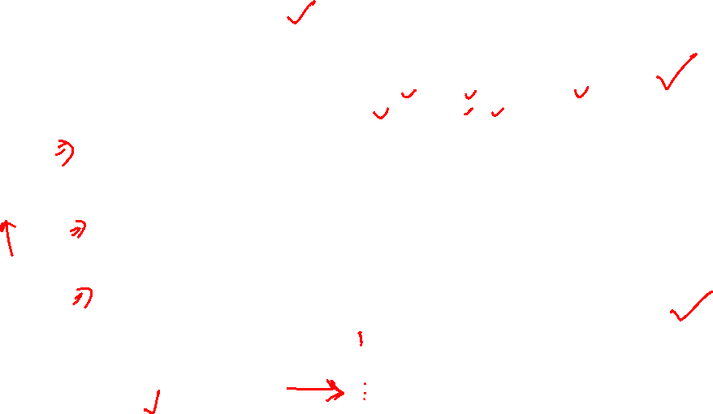
Motivation
LLM gets distracted by useless information
GitHub repo containing "Needle in a Haystack - Pressure Testing LLMs" tests, Kamradt, 2023.

Slide 8
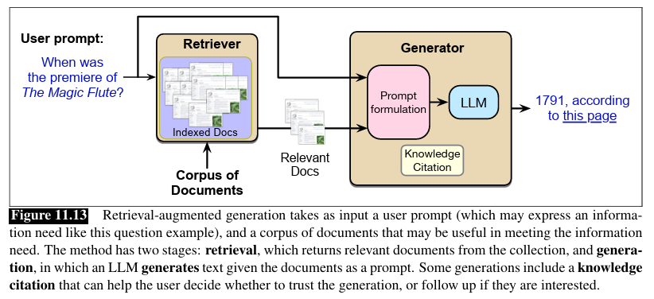
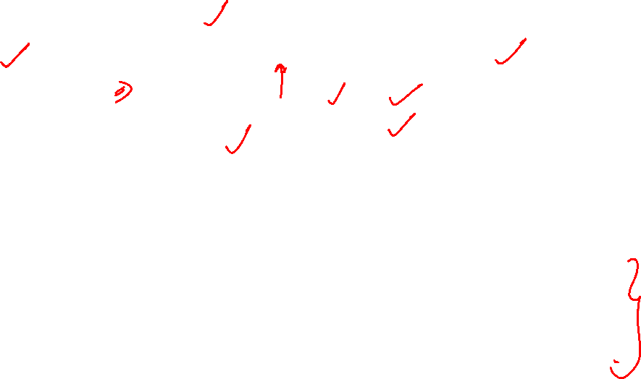
Retrieval-Augmented Generation (RAG)
1. Receive user query q
2. Call retriever → return top-k passages from D (BM25, vector search, or hybrid)
3. Assemble a prompt: instruction + q + retrieved passages
4. Call the LLM with the prompt → generate grounded answer

Slide 9
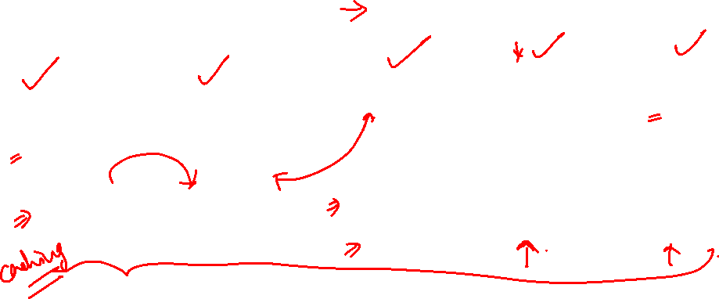
RAG pipeline
An offline pipeline builds the index; an online pipeline answers each query.
OFFLINE — build the index (runs when documents change)
Data
Chunk
Embed
Index
Store
docs, wikis, PDFs
split into passages
encode to vectors
ANN structure
vector DB
ONLINE — answer a query (runs on every request)
index serves queries
Query
Embed
Search
Rerank
LLM
user question
same encoder!
top-k chunks
refine to top-n
query + context
Online Embed must use the same model as the offline Embed — different encoders produce incomparable vectors.
Everything offline exists only to serve the online path

Slide 10
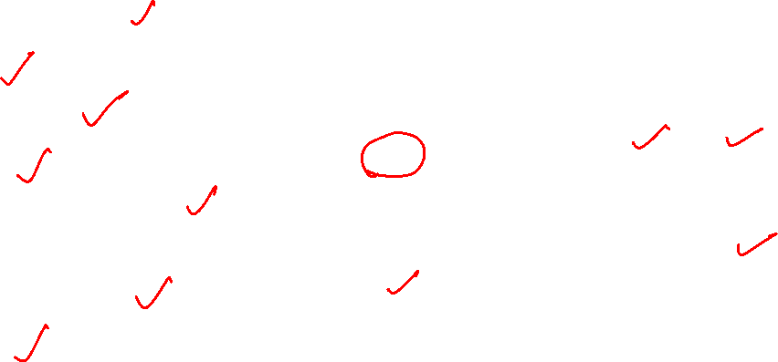
Building a RAG system: four key choices
What to index (offline: build the knowledge base) — which sources to bring in, at what granularity (document, section, paragraph), what metadata to attach, how to handle freshness/updates
How to chunk (offline: prepare units for retrieval) — fixed size, sliding window, semantic, recursive, or structure-aware splitting
How to retrieve (online: fetch candidates at query time) — sparse (BM25), dense (embeddings), hybrid, or multi-vector retrieval
How to rank (online: refine before sending to LLM) — balancing first-stage recall against second-stage precision via reranking

Slide 11
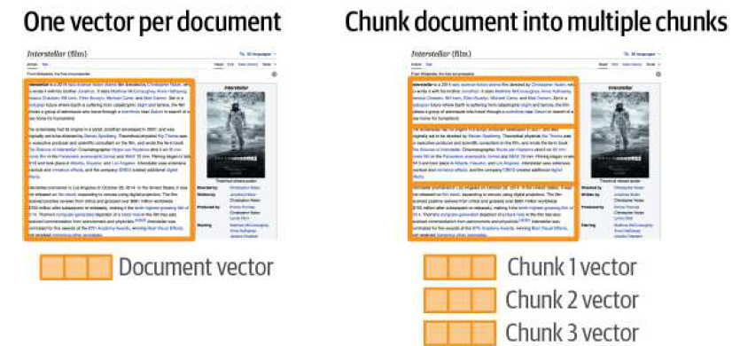
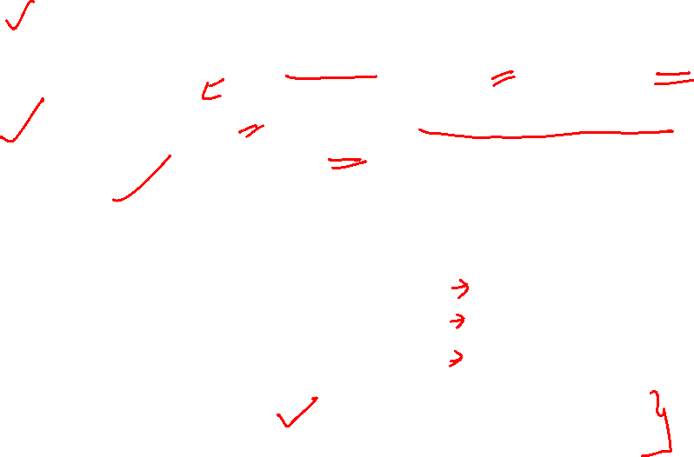
Why chunk at all?
Fit the window Retrieved text must fit into the LLM's context window along with query, instructions, and any few-shot examples
Retrieval granularity Smaller chunks → sharper matches; larger chunks → richer context.
Signal-to-noise Small enough that irrelevant sentences are excluded; large enough that a single chunk answers the question
Cost & latency Chunk size directly controls prompt cost.

Slide 12
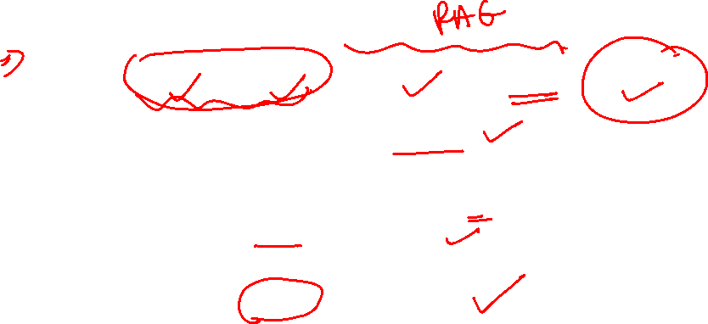
Why chunk at all?
Prompt cost formula:
tokens ≈ system + query + (chunk_size × top_k) + output
Retrieval slice dominates once top_k > 3
Chunk size is linear in cost (top_k = 5 fixed):
256 → 1,280 tok
512 → 2,560 tok
1024 → 5,120 tok
doubling chunk size doubles input cost

Slide 13
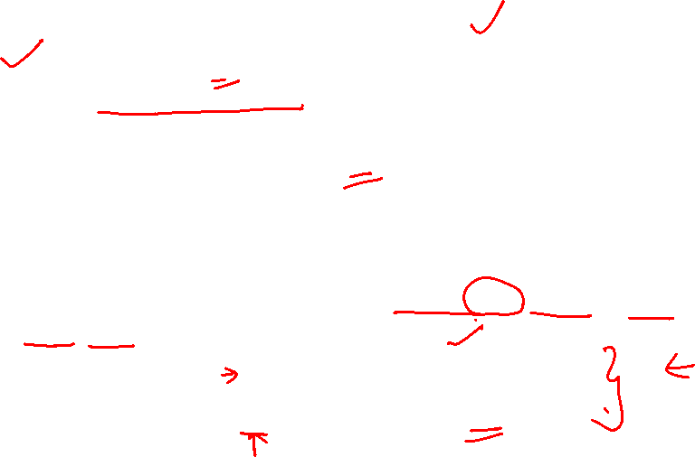
Why chunk at all?
Latency scales with prompt length via prefill: the model must read the entire prompt (prefill phase) before it can emit the first token — this wait is TTFT (time-to-first-token)
Generating tokens afterward (decode) is not affected by chunk size
Why it matters for RAG: doubling chunk size or top_k doubles the prefill work → user waits ~2× longer to see the answer start streaming
Order-of-magnitude numbers (Llama-3-70B, 8×A100, vLLM): prefill ≈ 3–5k tok/s per request
1k-token prompt ≈ 0.2–0.3s TTFT
5k-token prompt ≈ 1–1.5s TTFT
10k-token prompt ≈ 2–3s TTFT

Slide 14

Fixed-size Vs Sliding window
Split the document by a fixed count of tokens, words, or characters
Fixed-size chunks + overlap between adjacent chunks
Example (chunk_size = 40 chars)
chunk_size = 8 words, stride = 5 words
The transformer architecture was intro
Chunk 1 (words 1–8)
duced by Vaswani et al. in 2017. It r
the transformer architecture was introduced by Vaswani et
eplaced recurrent networks with self-
Chunk 2 (words 6–13)
attention. This let sequences be pro
by Vaswani et al in 2017 and used
cessed in parallel rather than one to
ken at a time.
Chunk 3 (words 11–16)
2017 and used self attention
Word "introduced" is split across chunks 1 and 2
Overlap of 3 words between consecutive chunks

Slide 15
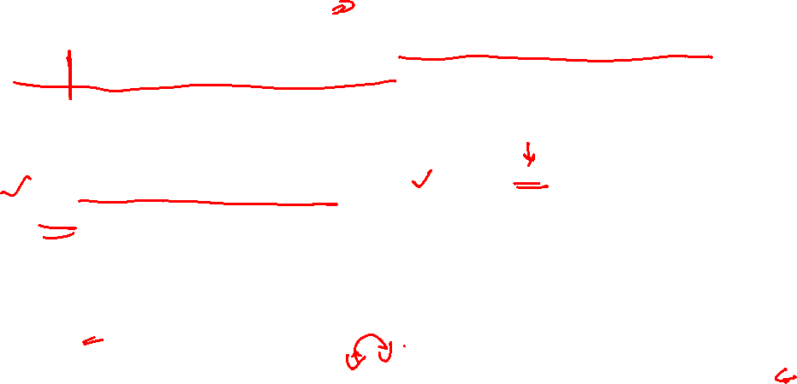
What fixed-size splitting breaks
Source text — the answer to “how many leave days carry forward?” is one sentence:
Q2 · CHUNK
… leave must be applied five days in advance. Employees may carry forward up to 10 unused leave days into the next calendar year. Carried-forward days expire on 31 March. …
Fixed size (no overlap) — the boundary lands mid-sentence:
Chunk A …applied five days in advance. Employees may carry forward up to 10 unused
Chunk B leave days into the next calendar year. Carried-forward days expire on 31 March…
Neither chunk contains the full fact → neither matches the query well → retrieval misses.
Sliding window (with overlap) — the overlap keeps the sentence whole somewhere:
Chunk A …applied five days in advance. Employees may carry forward up to 10 unused
Chunk B Employees may carry forward up to 10 unused leave days into the next calendar year. Carried-forward…
Chunk B starts earlier (overlap) → the full sentence survives in one chunk → retrieval works

Slide 16

What overlap costs: storage and duplicates
Overlapping chunks store the same text twice — and retrieval returns it twice.
Offline cost — double indexing
A sentence in the overlap zone lives in two chunks
It is stored, embedded, and indexed twice
~20–25% more chunks for typical overlap ratios
At millions of documents, that is real storage and compute
Online bug — duplicate hits
A query matching the overlapped sentence scores both chunks highly:
1 Chunk B · 0.89 — contains the sentence
Chunk A · 0.87 — contains the same sentence
Chunk F · 0.72 — genuinely new content
Ranks 1–2 are the same fact → 40% of the context budget wasted on redundancy.
Fix — dedup at retrieval time: over-retrieve (top-20), drop chunks of same doc_id, and large overlap ratio — or whose content hash matches — then keep the top-5 unique.

Slide 17


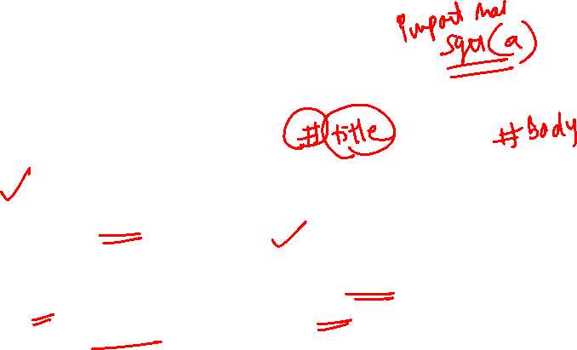
Structure-aware Chunking
Use the document's own structure — headings, sections, code blocks, table rows.
Markdown / HTML
Source code
Tables & forms
Split on # / ## headings.
Keep the heading trail (text after #/##) as chunk metadata.
Never split inside a code fence.
Split by function or class.
Keep imports as chunk header.
Language-aware tokenization.
Row-level chunks with column headers repeated.
Table caption included in every chunk.
Key idea: the document already knows where its natural boundaries are — use them before inventing your own.

Slide 18

Other chunking strategies
Sentence splitting: Sentence boundaries are used to split
Token-based splitting: Splitting the text based on a fixed number of tokens
Semantic chunking: Using NLP tools to identify coherent segments in the text. For instance, splitting a text based on topics or paragraphs. Embeddings can be used to find similarity
Hierarchical chunking: Dividing text into hierarchical sections, such as chapters,sections, and subsections.

Slide 19

Retrieval: measuring similarity between q and D
Represent q and d as vectors, then compare.
Sparse retrieval
Dense retrieval
Vectors are word-count histograms
Weighted by TF-IDF or BM25
Non-zero only for terms that appear
Strong keyword match; interpretable
Weak on synonyms, paraphrase
Vectors are learned embeddings (BERT, DPR, ...)
Dense — every dimension has a value
Captures meaning, not just words
Handles synonyms and paraphrase
Requires a model + vector index
Score = dot product or cosine between q and d representations, in both cases.

Slide 20




BM-25
|d_{avg}| = length of the average document
∣D∣ = length of document D (in terms)
t= term in Query q
BM25 score for each document can be calculated as
When k = 0, only idf.
b ranges from 1 (scaling by document length) to 0 (no length scaling)
Reasonable values are k = [1.2,2] and b = 0.75

Slide 21
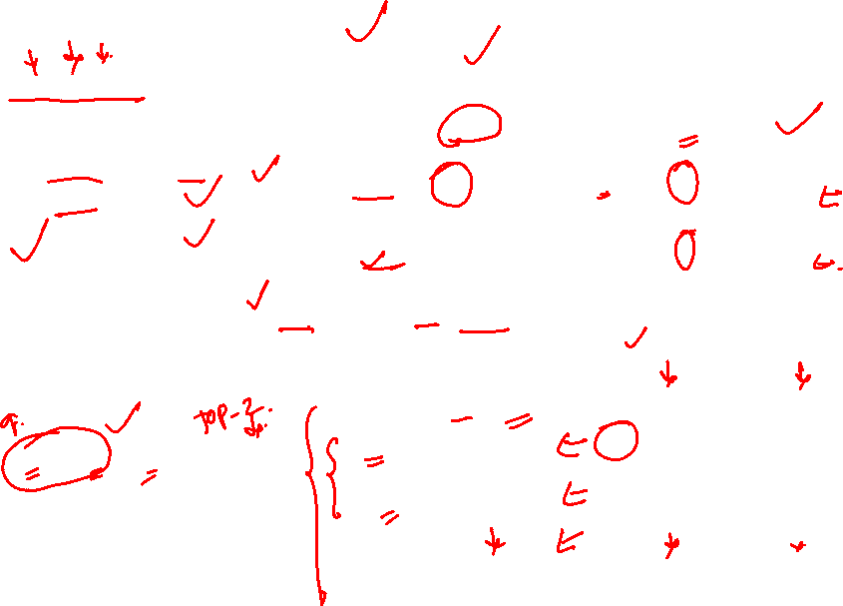
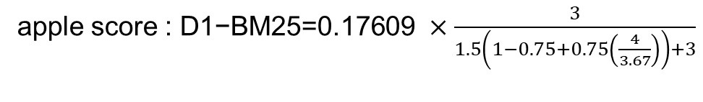
Example
Q = “apple banana”, K =1.5, b=0.75
Doc ID | Document Content
D1 | "apple banana apple apple"
D2 | "banana fruit banana orange"
D3 | "apple orange fruit"
Term | D1-tf | D2-tf | D3-tf | df | idf
apple | 3 | 0 | 1 | 2 | Log(3/2) =0.17609
banana | 1 | 2 | 0 | 2 | Log(3/2) 0.17609
apple score : $\text{D}\text{1−}\text{BM}\text{25=0.17609 }×\frac{3}{1.5\left(1−0.75+0.75\left(\frac{4}{3.67}\right)\right)+3}$
|D1| = 4, |D2| = 4, |D3| = 3
, |D_{avg}| = (4 + 4 + 3) / 3 = 3.67
Term | D1- BM25 | D2-BM25 | D3-BM25
apple | 0.11478541 | 0 | 0.07671302
banana | 0.06766826 | 0.09776676 | 0
total | 0.18245367 | 0.09776676 | 0.07671302
Rank: D1 > D3 > D2. Take top-k.
Document D1 is the most relevant to the query “apple banana” according to BM25

Slide 22
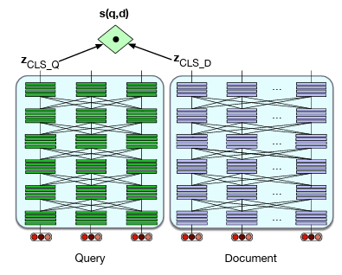

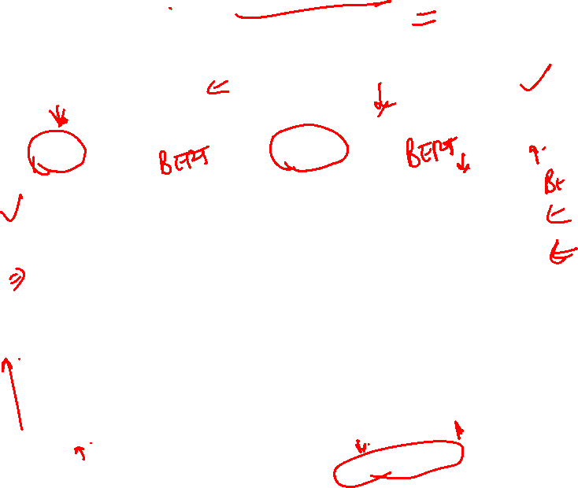
Dense retrieval bi-encoder (DPR)

Slide 23

Dense retrieval bi-encoder (DPR)
Cross-encoder alternative: BERT sees “[CLS] query [SEP] doc [SEP]” jointly
  Must re-run for every (query, doc) pair at query time
  O(N) BERT passes per query
Bi-encoder (DPR): query and doc encoded independently — doc vectors precomputed once, query encoded fresh each time
  Score: s(q, d) = z_{q} · z_{d} — a dot product
  O(1) per candidate
  Result: retrieval becomes ANN search over precomputed vectors (HNSW/IVF), not BERT inference
Cross-encoders are used as rerankers (10s of candidates, high quality per pair)
Bi-encoders are used as retrievers (millions of candidates, cheap per pair)

Slide 24
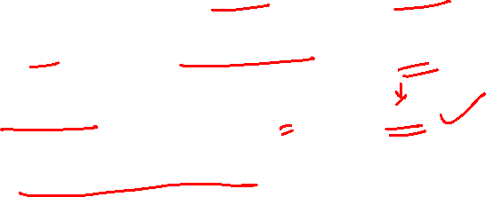
Vector indexing
Indexing is the process of organizing and structuring data to make it searchable
Enable queries over millions of vectors in milliseconds, two main approaches
Exact (brute-force)
  Scan all vectors, compute similarity to query
  Accurate, simple, slow at scale (O(N))
Approximate Nearest Neighbors (ANN) is a set of techniques designed to trade a small amount of accuracy (precision) for a massive increase in search speed.
  Comparing the query to every vector is too slow past ~100K. ANN looks at a small subset and still returns near-best results
  ANN algorithms pre-organize the vector space so the search engine only has to look in the "neighborhood" of the query.

Slide 25
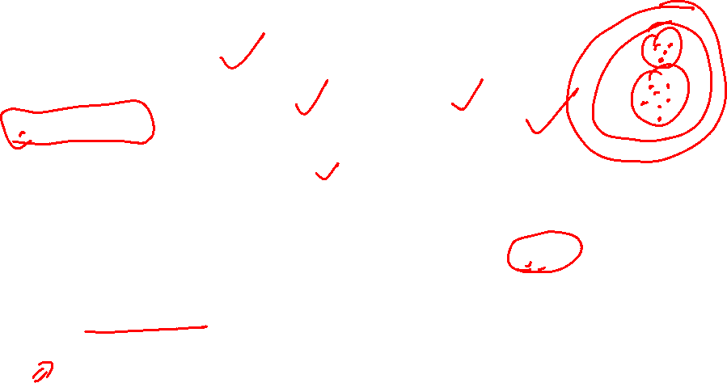
Approximate Nearest Neighbors (ANN)
Hierarchical Navigable Small World (HNSW)
  Uses a layered neighbor graph; search starts at the top, moves closer to the query, then descends to refine. Best for medium-large corpora when high recall and low latency matter, as long as the graph fits in RAM.
Inverted File Index (IVF)
  Uses k-means to cluster vectors at index time, so queries search only nearby clusters instead of the full dataset. Best for very large corpora

Slide 26
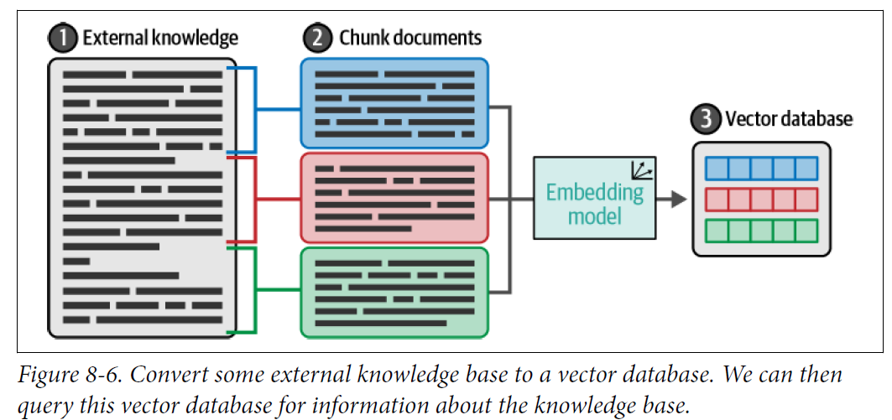
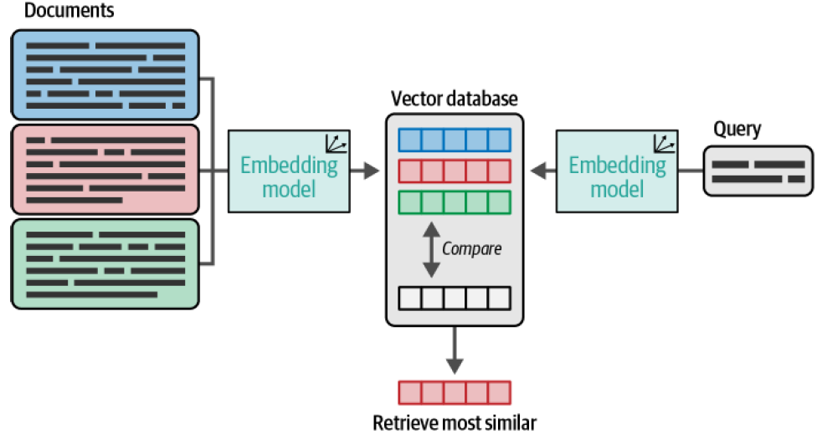

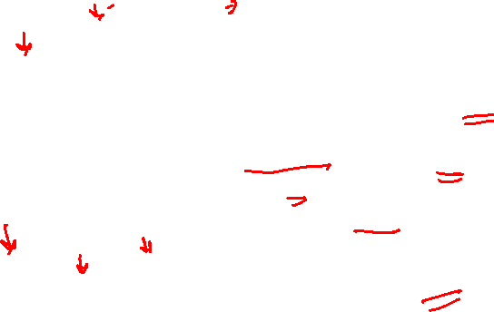
Vector database
Vector databases specialize in indexing and storing vector embeddings for fast semantic search and retrieval.
High-dimensional embeddings (384–1536 dims) alongside the original text and metadata is stored
Filter : on metadata (author, date, chapter) alongside similarity — hybrid SQL-like queries.

Slide 27



Vector database
Vector databases started as a specialized database offering,
But propelled by the growth in demand for storing vector data, all major database providers have added the vector indexing capability
Vector indexes: These are libraries that focus on the core features of indexing and search. They do not support data management, query processing, or interfaces. E.g. Facebook AI Similarity Search (FAISS)
Specialized vector DBs: These databases focus on the core feature of high dimensional vector support, indexing, search, and retrieval such as vector indexes, but also offer database features such as data management, extensibility, security, scalability, non-vector data support, and similar. Examples of specialized vector DBs are Pinecone, ChromaDB, Milvus, Qdrant, Weaviate, Vespa etc.

Slide 28
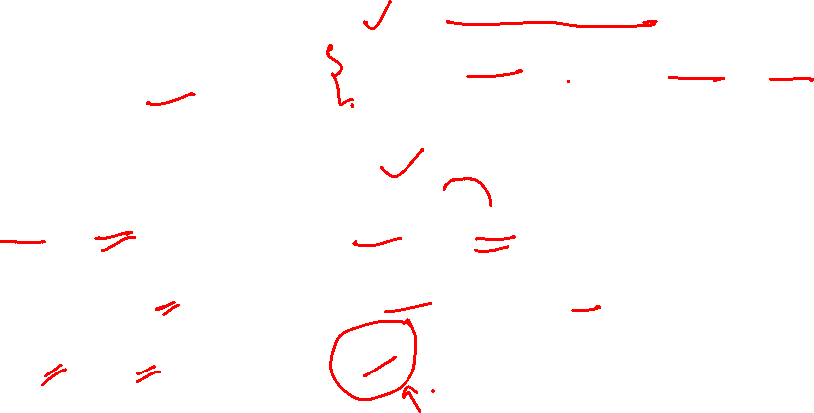
Vector database landscape
Category | Examples
Vector index libraries | FAISS, ScaNN, ANNOY, NMSLIB
Specialized vector DBs | Pinecone, Milvus, Qdrant, Weaviate, Chroma, Vespa, LanceDB
Search platforms | Elasticsearch, OpenSearch, Solr
SQL + vector | pgvector (Postgres), Azure SQL, SingleStore
NoSQL + vector | MongoDB, Redis, Cassandra
Graph + vector | Neo4j, ArangoDB

Slide 29
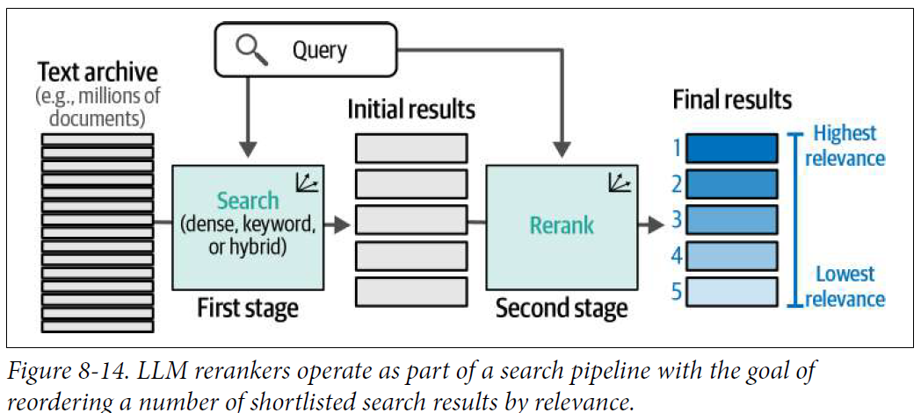
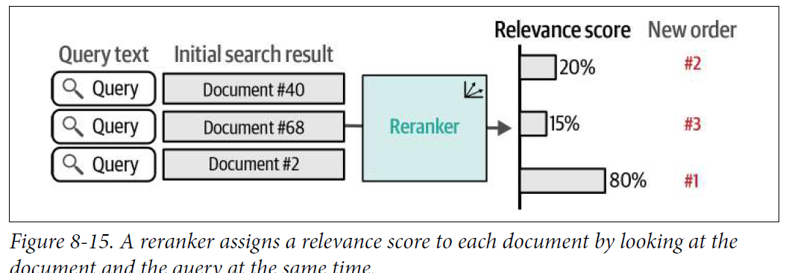
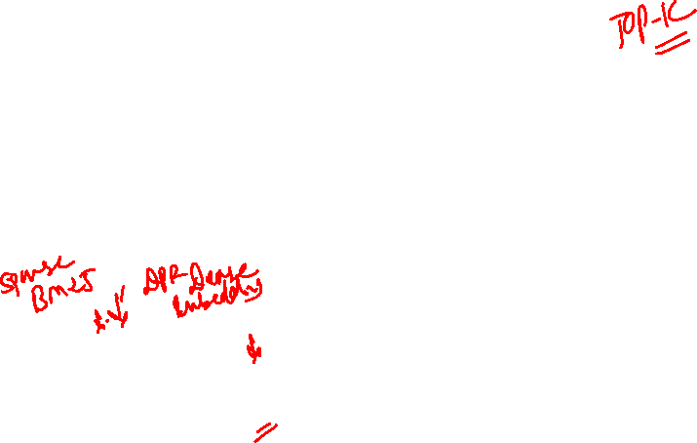
Reranker

Slide 30
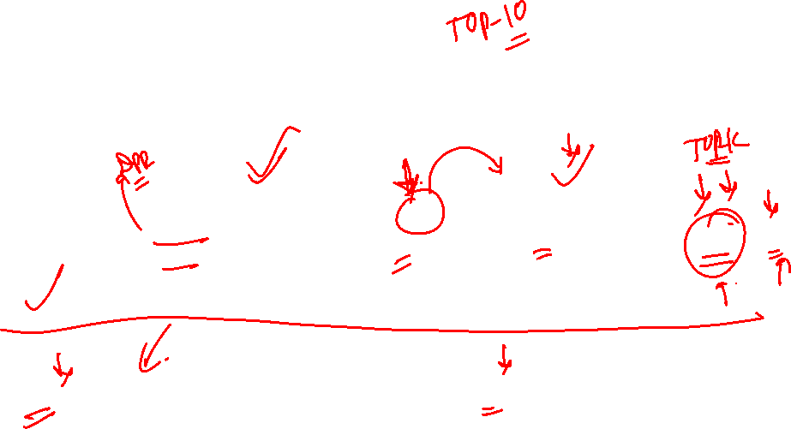
Retrieve, then rerank
Scoring millions must be fast. Putting the right answer at rank 1 must be accurate. No one model does both
Corpus
millions of vectors
Stage 1 Retriever
bi-encoder / BM25 — fast, coarse, whole corpus
top-100
candidates
Stage 2 Reranker cross-encoder — slow, precise, top-k only
top-5 → LLM
Recall — Stage 1’s job
Is the right answer somewhere in the top-k? Rank 47 is fine — presence is what counts.
Precision — Stage 2’s job
Of the candidates that came back, which truly answers the query? Order is what counts
Retriever keeps the right answer in the top-k, reranker puts it at rank 1.

Slide 31

Stage 1 architecture: the bi-encoder
Two towers, no communication — that is exactly what makes it fast.
Why this scales
Query
Document
g(doc) is computed once, offline, for every chunk — stored in the vector DB
At query time: one forward pass for f(query), then millions of dot products via the ANN index
Milliseconds over the whole corpus
The price: query and document never attend to each other
“carry-forward limit?”
policy chunk
f(query)→vector
g(doc)→vector
score = f(q) · g(d)
one cheap dot product
Bi-encoder = everything precomputable, nothing contextual.
SBERT, BGE, E5, OpenAI text-embedding models are all bi-encoders

Slide 32
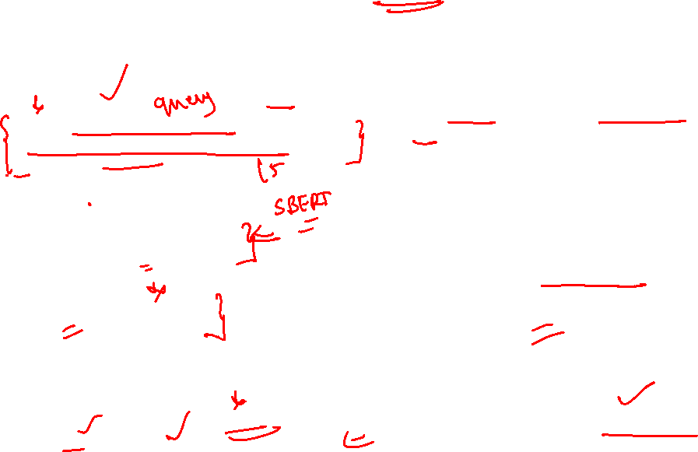
Stage 2 architecture: cross-encoder
One transformer reads query and document together — that is exactly what makes it accurate
query and document concatenated into one input
Why this is precise — and slow
Every query token attends to every document token
Catches what two fixed vectors blur: negation (“not effective”), word order, exact phrase matches, subtle intent
Nothing precomputable — the document’s representation depends on the query
One full transformer forward pass per (query, doc) pair → feasible for 100 candidates, impossible for 10 million.
[CLS] carry-forward limit? [SEP] Employees may carry forward up to 10… [SEP]
Transformer with full cross-attention
score = h(q, d)
a single relevance number per pair
Cross-encoder = everything contextual, nothing precomputable. Examples: BGE-reranker, Cohere Rerank, MiniLM cross-encoders

Slide 33
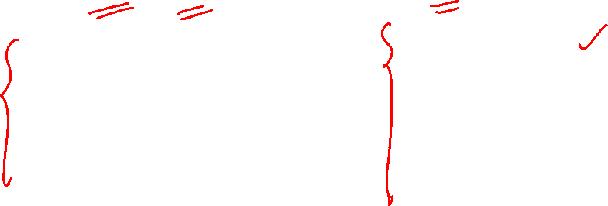
Reranking example
Query: “What is the maximum context length of Qwen2.5-3B?”
Q4 · RANK
Rank | Bi-encoder top-5 (before) | Cross-encoder top-5 (after)
1 | Qwen2.5-3B general description | Qwen2.5-3B context: 32K native, 128K with YaRN ✓
2 | Qwen2 context length notes | Qwen2.5 model card excerpt
3 | Llama context lengths | Qwen2.5-3B general description
4 | Qwen2.5-3B context: 32K native, 128K with YaRN ✓ | Qwen2 context length notes
5 | Qwen1.5 configuration | Llama context lengths
Read the table: recall already succeeded — the right chunk was in the top-5, at rank 4. The bi-encoder scored every “Qwen + context” chunk similarly. The cross-encoder, seeing query and passage together, recognized the exact fact match and promoted it to rank 1.

Slide 34
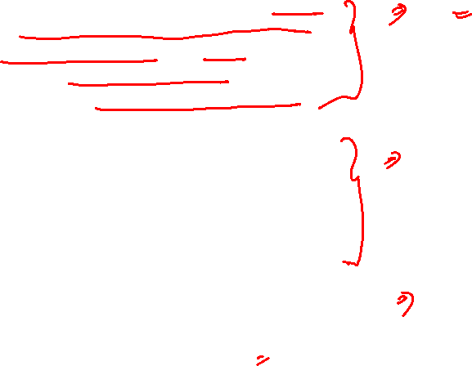
CONTEXT ENG : Anatomy of a RAG prompt
You are an HR policy assistant. Answer only from the context provided below. Cite the chunk id for every claim. If the answer is not in the context, reply exactly: "Not in the provided policy."
Context: [chunk 12 | Leave Policy > Carry-forward | 2025] Employees may carry forward up to 10 unused leave days into the next calendar year. [chunk 31 | Leave Policy > Encashment | 2025] Unused days beyond the limit are encashed.
Question: How many leave days can I carry forward?
Grounding rules
Scope the model to the context, force citations, and define the refusal string — deterministic, testable behaviour.
Chunks with metadata
Each chunk carries its id, heading trail, and version — the model can cite, and you can audit
Query placed last
model reads the evidence before the question — and recency keeps the question in strong attention.

Slide 35

CONTEXT ENG: some tips
When model memory conflicts with retrieved context, instruct the model to treat the retrieved chunk as the authoritative and more recent source.
Use metadata like version and date to reinforce that the chunk should win.
Attention across the context window is strongest at the start and end, and weakest in the middle, Important chunks should never be buried in the middle.
Prefer fewer, higher-quality chunks over many mediocre ones.
Reranking matters twice: it selects the best chunks and helps assign them to the highest-attention positions

Slide 36
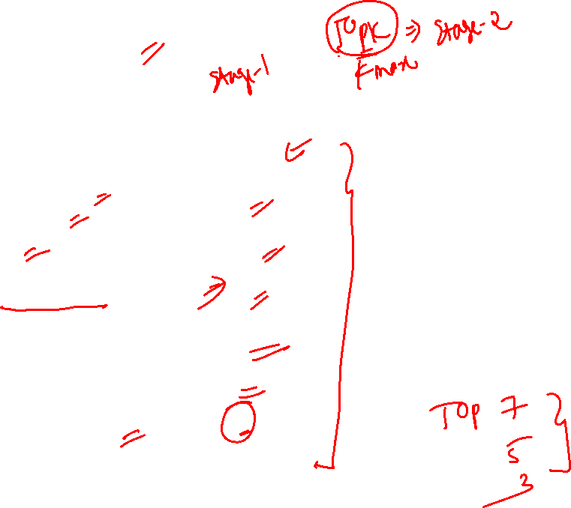
Token budget arithmetic
8K-context model
Context window | 8,000
System instructions + grounding | 600
Chat history kept | 1,400
Generation headroom (max_new_tokens) | 1,000
Budget left for retrieved chunks | 5,000
Average chunk size | 700
Chunks that fit (top-k ceiling) | 7
Fitting 7 chunks does not mean sending 7 — lost-in-the-middle argues for fewer, better-ranked chunks
Generation headroom is often forgotten
History grows every turn — decide a truncation or summarization policy before it silently eats the chunk budget

Slide 37
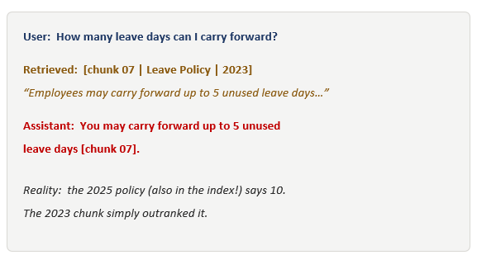
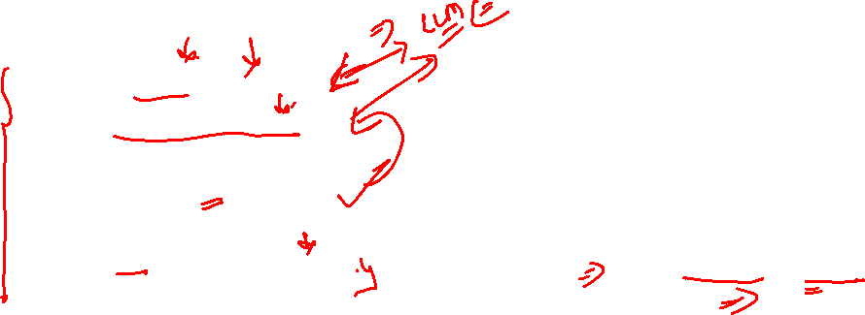
Failure transcript 1: confident but wrong
DEBUG
Read the transcript, then trace the fault upstream.
The model behaved correctly: grounded, cited
The retrieval was the fault: stale version won the similarity contest
Fix at Q1 (what to index): remove or down-rank superseded versions; filter on a version/date metadata field
A grounded, cited, wrong answer is a retrieval bug, not the LLM bug

Slide 38
Failure transcript 2: the context was ignored
DEBUG
Same setup — different fault, different fix.
User: How many leave days can I carry forward?
Retrieved: [chunk 12 | Leave Policy | 2025]
“Employees may carry forward up to 10 unused leave days…”
Assistant: Carry-forward rules vary, but most
companies allow around 5 days per year
Reality: the correct chunk WAS in the prompt
The model answered from memory anyway
Retrieval succeeded — the right chunk arrived
The prompt was the fault: no grounding rules, chunk buried mid-prompt after long history
Fix at the prompt: add grounding + conflict rules, move chunks out of the middle, trim history

Slide 39
Debugging RAG from the output backward
Every bad answer points to an upstream design decision. Learn to read the symptom.
Symptom in the answer | Likely cause upstream | Where to fix
Confident but wrong | Wrong chunk retrieved; model trusted it | Retrieval / reranking
Ignores the provided context | Weak grounding; parametric memory wins the conflict | Prompt (grounding rules)
“Not in context” — but it was | Chunk formatting unreadable; over-strict instructions | Chunking / prompt
Vague or partial answer | Needed 3 chunks, got 1; chunk too small for the idea | Chunk size / top-k
Same fact stated twice | Overlapping chunks retrieved, no dedup | Sliding-window dedup
Before blaming the model, read what was actually retrieved. Most “LLM errors” in RAG are retrieval or prompt errors

Slide 40

Advanced RAG = prompt patterns you've already seen
RAG technique | Underlying prompt pattern | Mechanism
Query rewriting | Input normalization (preprocessing prompt) | An LLM cleans the user's messy or verbose input before the "real" pipeline runs.
Multi-query RAG | Query decomposition / fan-out | One user question → several independent sub-queries dispatched in parallel; results merged.
Multi-hop RAG | Iterative / sequential reasoning (ReAct-style) | Later steps depend on the output of earlier ones. Same loop; the "tool" happens to be the retriever.
Query routing | Classifier + router | A small classifier picks which downstream source or tool handles the query — e.g., HR docs vs CRM vs general web.

Slide 41
Agentic RAG
Classical RAG is a fixed pipeline, every query goes through retrieve → generate
Agentic RAG replaces pipeline with a decision-maker, LLM chooses
  whether to retrieve,
  which source to hit (e.g., "employee count" → SQL, "policy wording" → vector index)
  how many times,
  when to stop
Retriever becomes one tool the agent uses, not a mandatory stage
For complex questions, the agent writes a short plan: "first fetch the policy, then look up the exceptions, then compare" — and executes the steps in order
What you tune shifts from chunking and top-k to agent-loop controls — step budgets, stop conditions, and tool schemas

Slide 42
Agentic RAG
Self-check and retry. After retrieval, agent scores its own chunks: are these actually relevant? do they answer the question? If the score is low, it rewrites the query and retrieves again. Bounded by a max-retry budget so it doesn't loop forever. This is the Self-RAG idea.
ReAct loop: Agent alternates Thought → Action → Observation: think about what's missing, call a tool (often the retriever), read the result, think again. Continues until it decides it has enough to answer, or hits a step limit.
Memory across turns. In multi-turn use, agent carries forward what it retrieved earlier so it doesn't re-fetch the same chunks. Long conversations get summarised to stay within the context window.

Slide 43
When not to use RAG
Approach | Use it when | Example
Fine-tuning | Teach style, format, or a narrow stable skill | Knowledge is small, stable, and behavioural — "always answer in our report format"
Long-context prompting | One-off document that fits the window | A single contract to summarize — no index needed
Tool use / function calling | Answer is computed, not retrieved | "What is 12% of my invoice total?" — call a function, don't search
RAG | Large, changing knowledge that needs citation | Company wiki, product docs, research corpus
Agentic RAG | Query needs decomposition or multiple retrieval rounds | "Compare our 2024 and 2025 leave policies" — two retrievals + synthesis

Slide 44
References
Speech and Language Processing Book by Daniel Jurafsky and James H. Martin, Ch 11 – Jan 2026 edition
Generative AI in Action by Generative AI in Action, MANNING publications, Ch 7
A Simple Guide to Retrieval Augmented Generation by Abhinav Kimothi, MANNING publications, Ch 6
Hands-On Large Language Models, Jay Alamar – Ch 8
Research papers
RAFT: Adapting Language Model to Domain Specific RAG
SELF-RAG: LEARNING TO RETRIEVE, GENERATE, AND CRITIQUE THROUGH SELF-REFLECTION
REALM:Retrieval-Augmented Language Model Pre-Training
ATLAS – Few-Shot Learning with Retrieval-Augmented LMs
Open-RAG – Optimizing RAG End-to-End via In-Context Learning (2025)

